Slide 1

Planning for 2020-21
Dr. Jill Siler, Superintendent
School Board / Staff Presentation
May 18, 2020

Slide 2
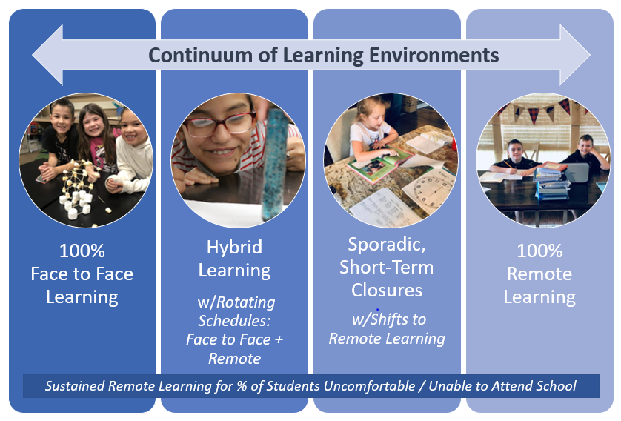

Slide 3








Decision-Making Process

Slide 4

100% Face to Face Learning how we started 2019-2020
→ OUR GOAL
  Why is this Important?
    Best pedagogical approach
    Disparity in remote learning
    Best meet individual student needs
    Social / emotional connection for students
    Ability to participate in extracurricular activities

Slide 5
100% Face to Face Learning how we started 2019-2020
  What would prevent this?
    National, State or Local Closure Order
      Preventative or Due to Spread
    Social Distancing Requirements
  What would allow this? (100% return with no social distancing)
    National, State or Local Order
    Vaccine or Treatment
    Slow in Spread of COVID
    Change in Research

Slide 6

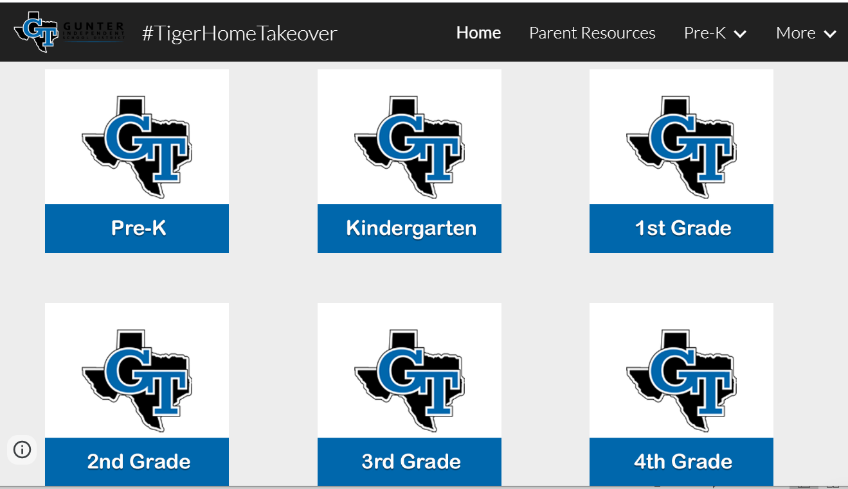

100% Remote Learning
how we ended 2019-2020
  What we Did:
    PK: Mailed home materials weekly + online songs/games
    K-8: Google Sites w/Google Slides
      Linked to SeeSaw and Google Classroom on the backside
    9-12: Google Classroom
    ALL: Zoom for Class Meetings / Small Groups

Slide 7

100% Remote Learning
how we ended 2019-2020
Questions to Answer:
  What worked? What needs to be adjusted/improved?
  What is the best mix of synchronous / asynchronous teaching & learning?
  What are reasonable expectations when learning is shifted to 100% Remote?
    # of hours per day per grade level?
    grading expectations?
    curriculum coverage?
  How do we ensure quality instruction at every level?
  How do we best sustain connection, build community and support our student’s learning needs?

Slide 8
100% Remote Learning
how we ended 2019-2020
Sustained Remote Learning for % of Students Uncomfortable / Unable to Attend School
Even if we are able to return to face to face instruction in some sort of capacity, there will be a group of students unable to or uncomfortable in returning to school.
Will we provide sustained remote learning for them?

Slide 9

Sporadic, Short-Term Closures
what we can expect 2020-2021
  How to Prepare –> “Be Nimble”
    Devices: Shift to 1:1
    Internet: Survey families & deploy hotspots
    Platforms: Maintain & Prepare
    Training: Continue PD around Remote Learning
  How to Decide –> “Determine the Rules”
    When would we need to close?
      Who is determining the rules?

Slide 10
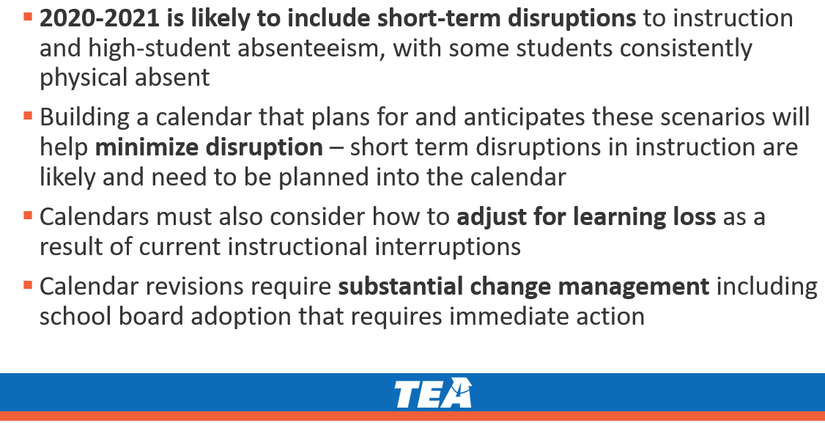
Sporadic, Short-Term Closures
  TEA Recommendations
    Intersessional Calendar
    Additional Days School Year Calendar

Slide 11
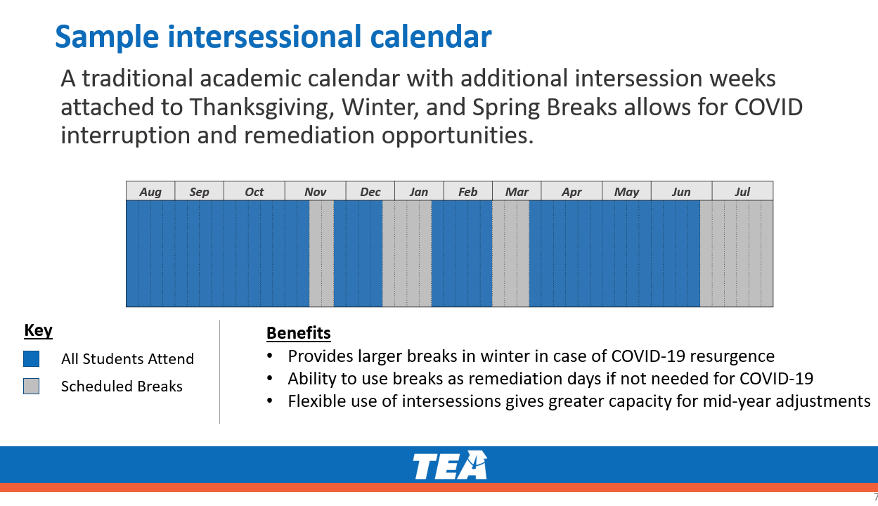

Slide 12
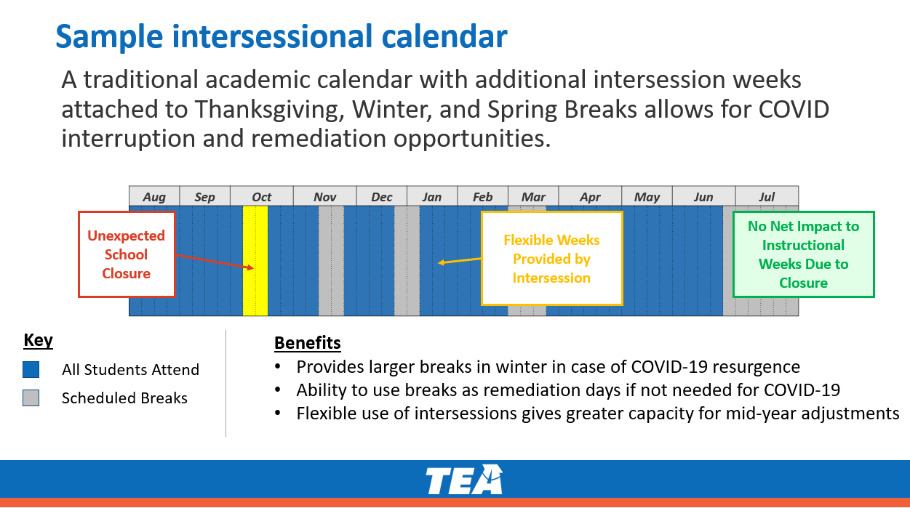

Slide 13
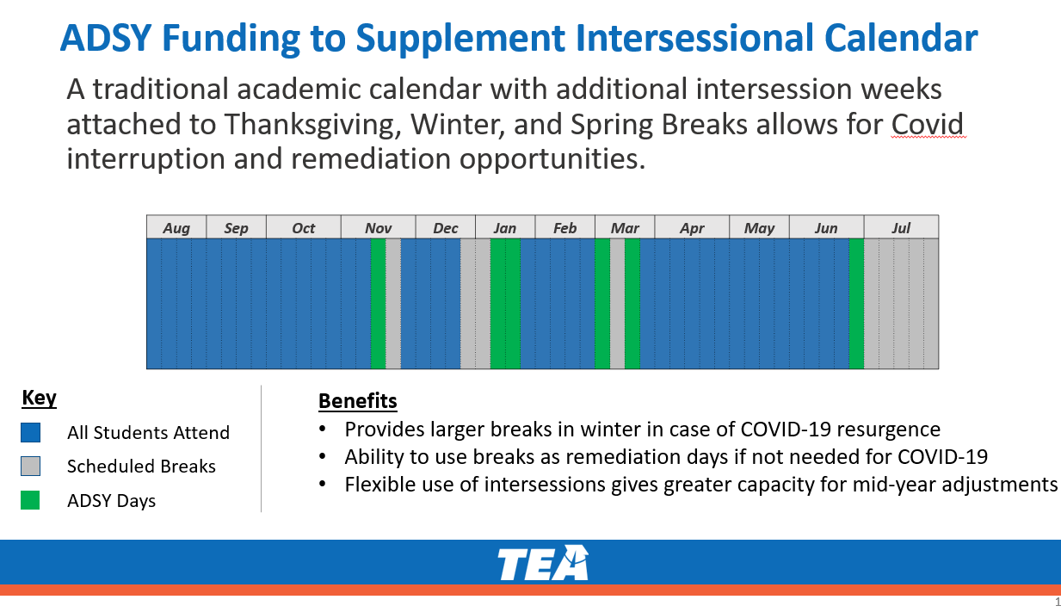

Slide 14
Sporadic, Short-Term Closures
what we can expect 2020-2021
  Challenges with Intersessional / Additional Days
    Cannot “schedule” COVID
    “Stopping” instruction for weeks on end is not best
    While both calendars have 187 days, in the intersessional, teachers would be “on call” for 11 months a year as any week could be re-claimed
    With the economic fallout that is coming, raising salaries to increase school days could be unsustainable

Slide 15

Hybrid Learning
what could be new in 2020-21
Face to Face Learning + Remote Learning w/Rotating Schedules
Why? Social Distancing

Slide 16
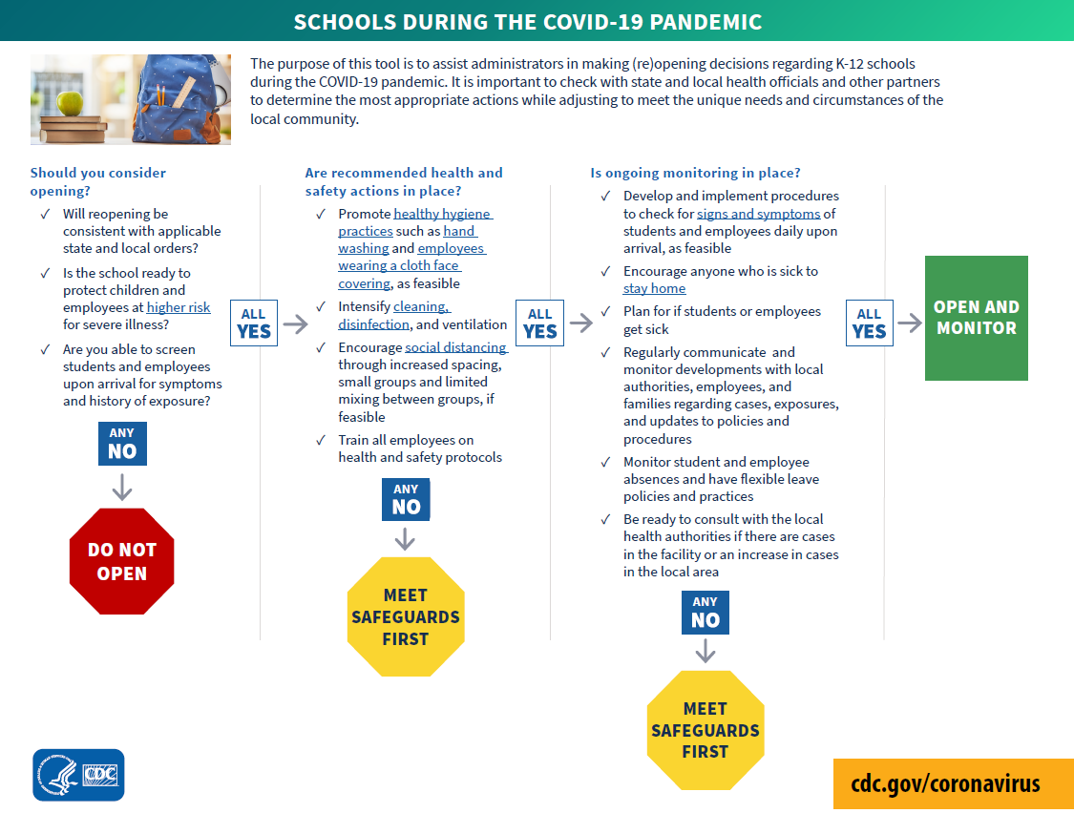

Slide 17
“protect children and employees and higher risk”
  People 65 years and older
  People of all ages with underlying medical conditions, including:
    People with chronic lung disease or moderate to severe asthma
    People who have serious heart conditions
    People who are immunocompromised
      cancer treatment, smoking, bone marrow or organ transplantation, immune deficiencies, poorly controlled HIV or AIDS, and prolonged use of corticosteroids and other immune weakening medications
    People with severe obesity (body mass index [BMI] of 40 or higher)
    People with diabetes
    People with chronic kidney disease undergoing dialysis
    People with liver disease

Slide 18
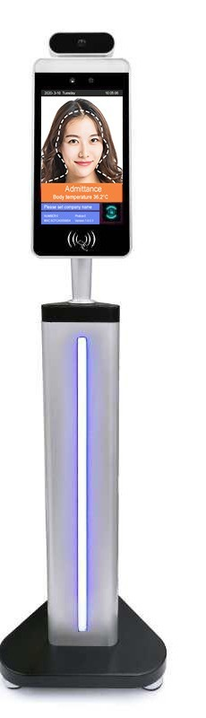
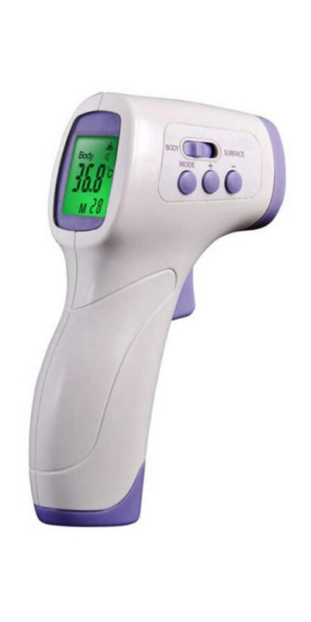
“screen students and employees upon arrival”
  Health Questionnaire
  Screen for Symptoms
    Temperature Checks
    How long do people have to stay home if they have a fever?
    How long do people have to stay home if they’ve been exposed?
    How is leave handled when we force an employee to stay home?

Slide 19
Hand Washing
Employees wearing a cloth face covering
Cleaning / Disinfecting
  Not daily → Every class period
  Ventilation?!?
Social Distancing
Limited Mixing Between Groups
Training

Slide 21


Slide 22
TEA Summer School Guidance (May 18, 2020)
No more than 11 students in a group (including teachers & staff)
Desks must be 6 feet apart
All students should be 6 feet apart at all times
  TEA notes this may not be feasible for early childhood and special needs
Students should be self-contained (limited travel to other classes)
If multiple groups are in the same area, groups must be 30 feet apart
No group work or pairs work or assemblies or field trips
Preferable to gather outside

Slide 23
TEA Summer School Guidance (May 18, 2020)
No choir, wind instruments, indoor sports
Gyms, weight rooms and indoor facilities to remain closed
All staff should be screened daily
Student temperatures should be taken daily
Hand sanitizer should be at every entrance and required for entry onto the campus
Students should wash hands after touching anything someone else has touched
Students should wash hands at least 2 times a day and after using restroom and eating (handwashing should be supervised)

Slide 24
TEA Summer School Guidance (May 18, 2020)
Employees and students should wear cloth face coverings (over nose and mouth)
Where possible, dividers should be placed on desks
Students should eat lunch at their desks
Students should remain 6 feet apart while at recess
  Consider using cones, caution tapes or natural barriers to keep groups apart
Everything should be cleaned in between groups of students
Consider staggering start/end times
Buses: group by class, 6 feet apart, hand sanitizer
Positive Cases: that individual and all people with regular contact must stay home for two weeks

Slide 25
Hybrid Learning
what could be new in 2020-21
Face to Face Learning w/Rotating Schedules
Why? Social Distancing
Models Proposed by Ed Leaders:
  A/B Day: ½ attend on Mon/Weds, ½ attend Tues/Thurs
  A/B Week: ½ attend one week; ½ attend the next week
  AM/PM: ½ attend morning; ½ attend afternoon
  Elem/Secondary: Elem attends in person; Secondary remote

Slide 26
Hybrid Learning
what could be new in 2020-21
Challenges in Social Distancing at School
  Arrival
  Dismissal
  Buses
  Lunches
  Class Transitions
  Restroom Breaks
  PE / Athletics
  Recess
  Music / Band / Choir
  Extracurricular Activities
  Maintaining Distance in all places
  Hand Washing

Slide 27
Hybrid Learning
what could be new in 2020-21
Challenges for Staff: (PS - this is not feasible)
Teach different groups of kids every day/week
Sustain the offline learning for those groups of kids on the off days
Teach a completely remote version of your class for the kids who cannot or choose not to come at all
For those that are parents, serve as a homeschool teacher for your own kids throughout as they’re not receiving daily instruction. PS - Where do their children go on the “off” days?

Slide 28
2 Things that Will
Dictate Fall 2020…
If the rules require:
  6 feet of distance or required ratios of students 10:1 or 11:1
  14 day quarantine for anyone who tests positive and anyone they’ve been in regular contact with

Slide 29
Planning for 2020-2021
We may not know what the 2020-21 school year will look like at any given moment, but we do know that it will fall into some part of this continuum.
As leaders, we must prepare for it all.

Slide 30
Helpful Links
CDC Guidance for School Re-Opening
School Superintendents will Follow Leaked CDC Guidance on Reopening Schools
“Between 0 and 100%”: Texas schools weigh the odds of students returning this fall
NIET – Scenario Planning: Considerations for 2020-21
Arizona’s three-phase approach to crafting school reopening plan
7 questions schools will have to answer to reopen in fall 2020
Katie Martin: 6 Ideas for Creating a Remote Community of Learners
Larry Ferlazzo: Best Posts Predicting What School Will Look Like in the Fall
George Couros: 5 Hopes for When Schools Reopen Face-To-Face
Jeremy Parrish: Do I Dare Disturb the Universe?

