Slide 1



Planning for 2020-21
Dr. Jill Siler
Gunter ISD Superintendent

Slide 2
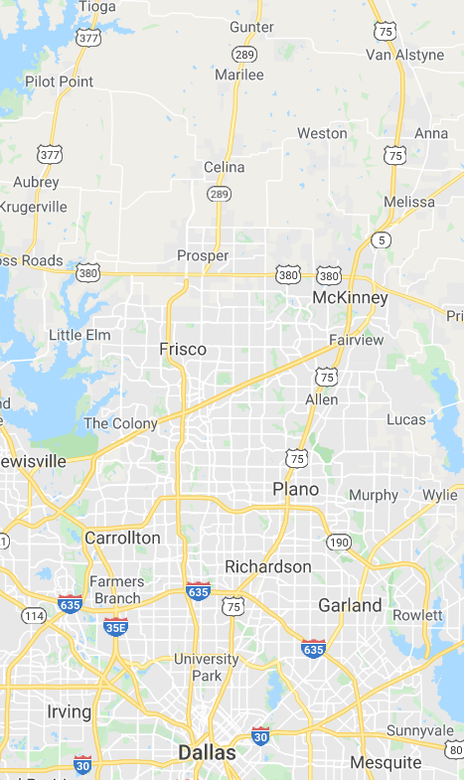
Gunter ISD
  1,000 Students
  25 minutes north of Frisco
  Technology - Not 1:1
  Internet Access is a Challenge
  30-40% Poverty (Title 1 Campus)

Slide 3
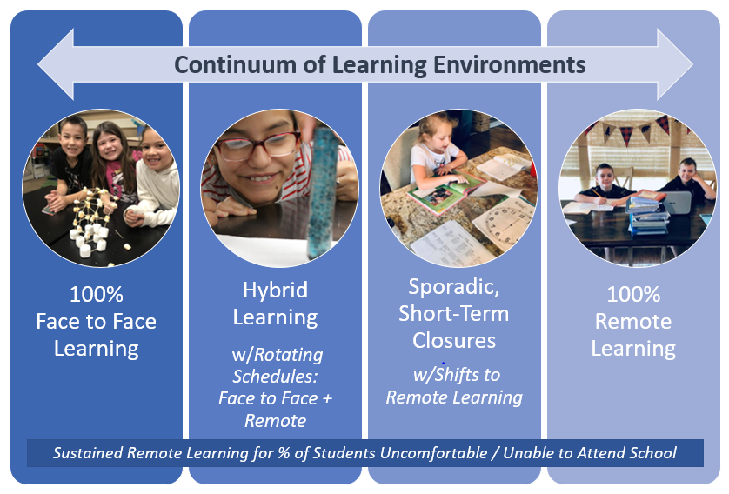
jillmsiler.com/2020/05/16/into-the-unknown/

Slide 4






Decision-Making Process
YOUR COUNTY
YOUR DISTRICT

Slide 5
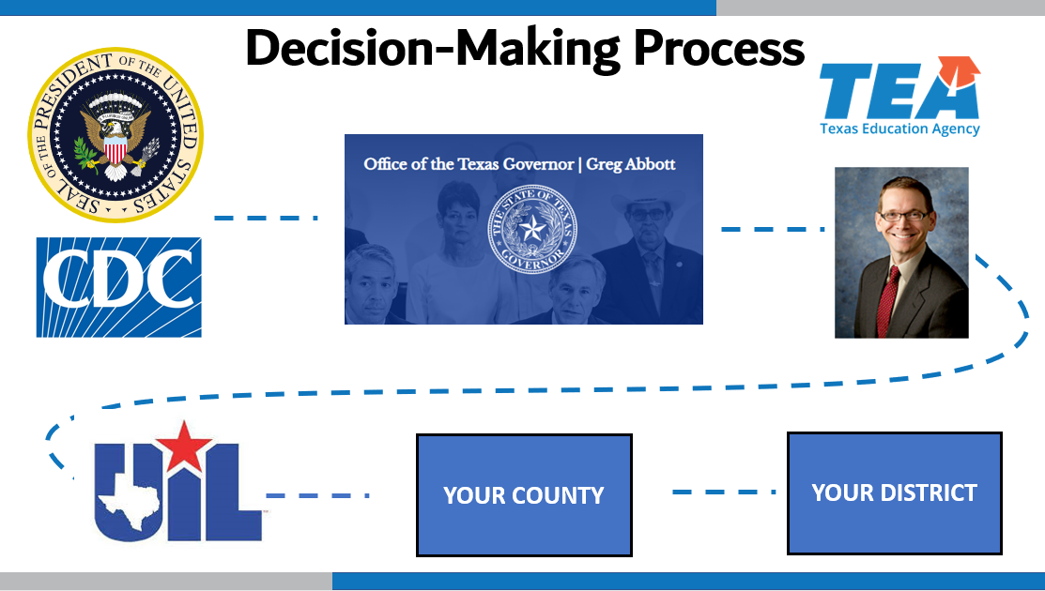
I know many of you are waiting on our decisions around what the fall will look like, but the truth is some of the biggest decisions that will impact what will happen are not currently in our hands to make…
One of the challenging aspects of this planning is that these decisions have not yet been made for 2020-21, nor have we been given a timeline for when those decisions will be made.
Excerpt from a parent letter…

Slide 6

screening
masks
choir / band
surface cleaning
hand-washing
arrival
CDC guidelines
communication structures
large group gatherings
recess
lunch
plexiglass
6 feet of space
visitors
staffing
hand sanitizer
schedules
dismissal
learning platform
buses
face shields
extracurriculars

Slide 7
3 Questions that Will Dictate Fall 2020
  Will TEA require 6 feet of social distance or required ratios of students (i.e., 10:1 or 11:1)?
  Will TEA require a 14 day quarantine for anyone who tests positive and anyone they’ve been in regular contact with?
  Will TEA continue to fund schools for providing remote learning for students unable or unwilling to attend or during short-term closures?

Slide 8
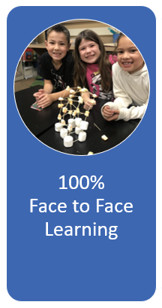
100% Face to Face Learning how we started 2019-2020
→ OUR GOAL
  Why is this Important?
    Best pedagogical approach
    Disparity in remote learning
    Best meet individual student needs
    Social / emotional connection for students
    Ability to participate in extracurricular activities

Slide 9
100% Face to Face Learning how we started 2019-2020
  What would prevent this?
    National, State or Local Closure Order
      Preventative or Due to Spread
    Social Distancing Requirements
  What would allow this? (100% return with no social distancing)
    National, State or Local Order
    Vaccine or Treatment
    Slow in Spread of COVID
    Change in Research

Slide 10

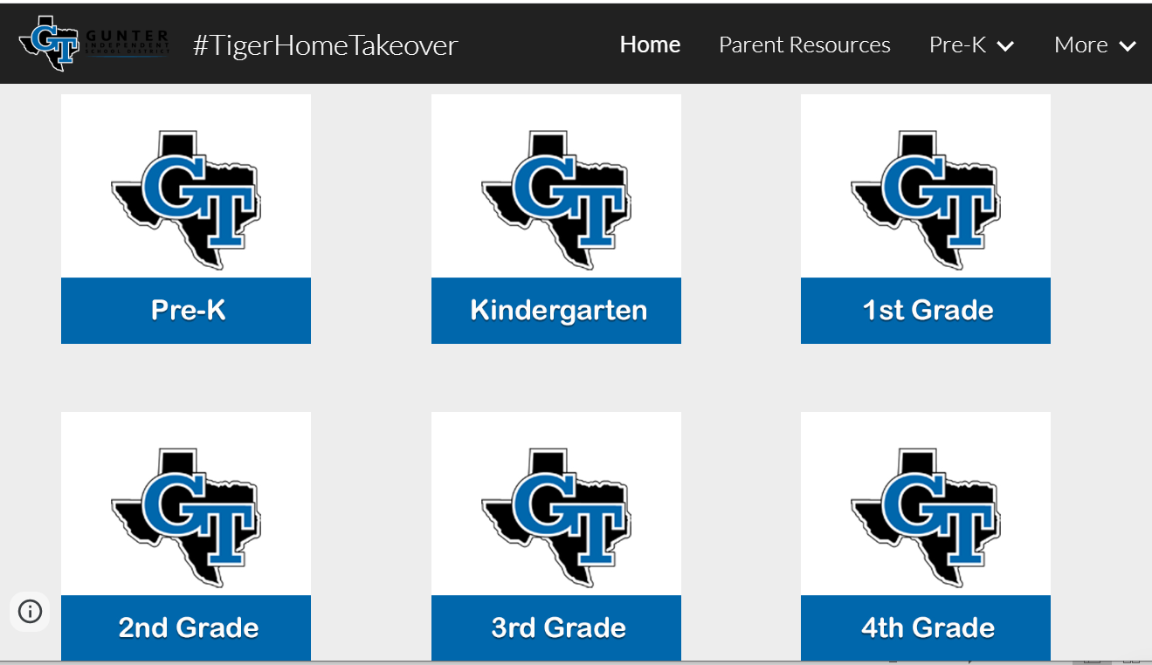

100% Remote Learning
how we ended 2019-2020
  What we Did:
    PK: Mailed home materials weekly + online songs/games
    K-8: Google Sites w/Google Slides
      Linked to SeeSaw and Google Classroom on the backside
    9-12: Google Classroom
    ALL: Zoom for Class Meetings / Small Groups

Slide 11
Remote Learning

Slide 12
100% Remote Learning
how we ended 2019-2020
Questions to Answer:
  What worked? What needs to be adjusted/improved?
  What is the best mix of synchronous / asynchronous teaching & learning?
  What are reasonable expectations when learning is shifted to 100% Remote?
    # of hours per day per grade level?
    grading expectations?
    curriculum coverage?
  How do we ensure quality instruction at every level?
  How do we best sustain connection, build community and support our student’s learning needs?

Slide 13
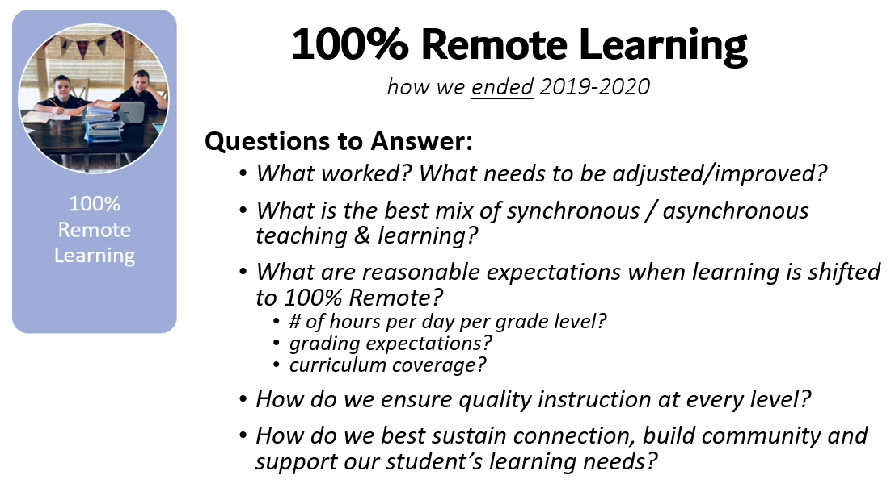
Feedback:
Parent Surveys
Teacher Surveys
Leadership Team Feedback
Teacher Committees

Slide 14
100% Remote Learning
how we ended 2019-2020
Sustained Remote Learning for % of Students Uncomfortable / Unable to Attend School
Even if we are able to return to face to face instruction in some sort of capacity, there will be a group of students unable to or uncomfortable in returning to school.
Will we provide sustained remote learning for them?

Slide 15

Sporadic, Short-Term Closures
what we can expect 2020-2021
  How to Prepare –> “Be Nimble”
    Devices: Shift to 1:1
    Internet: Survey families & deploy hotspots
    Platforms: Maintain & Prepare
    Training: Continue PD around Remote Learning
  How to Decide –> “Determine the Rules”
    When would we need to close?
      Who is determining the rules?

Slide 16
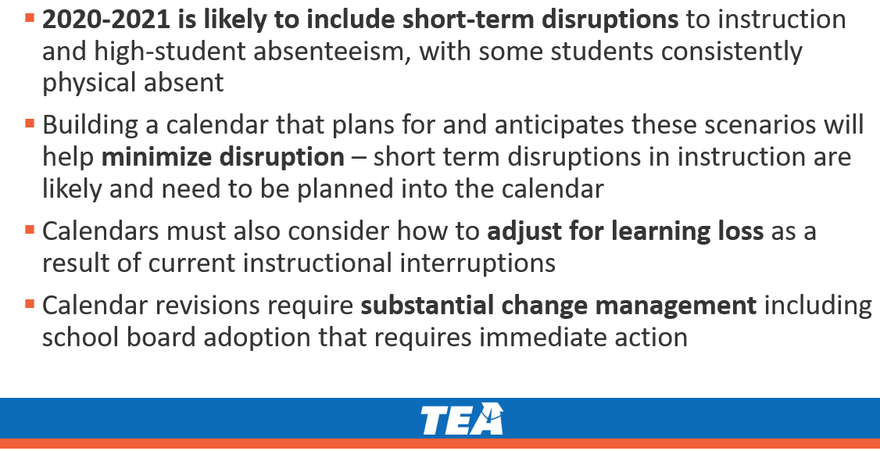
Sporadic, Short-Term Closures
  TEA Recommendations
    Intersessional Calendar
    Additional Days School Year Calendar

Slide 17
Sporadic, Short-Term Closures
what we can expect 2020-2021
  Challenges with Intersessional
    Cannot “schedule” COVID
    “Stopping” instruction for weeks on end is not best
    While both calendars have 187 days, in the intersessional, teachers would be “on call” for 11 months a year as any week could be re-claimed

Slide 18

Hybrid Learning
what could be new in 2020-21
Face to Face Learning + Remote Learning w/Rotating Schedules
Why? Social Distancing

Slide 19
Hybrid Learning
what could be new in 2020-21
Face to Face Learning w/Rotating Schedules
Why? Social Distancing
Models Proposed by Ed Leaders:
  A/B Day: ½ attend on Mon/Weds, ½ attend Tues/Thurs
  A/B Week: ½ attend one week; ½ attend the next week
  AM/PM: ½ attend morning; ½ attend afternoon
  Elem/Secondary: Elem attends in person; Secondary remote

Slide 20
Hybrid Learning
A/B Day Model: ½ attend on Mon/Weds, ½ on Tues/Thurs
  Mitigates technology issues
    Direct teach / Direction for at home
  Fridays
    Intervention/enrichment for students
    Professional development / planning for teachers
Challenges with synchronous learning

Slide 21
Hybrid Learning
what could be new in 2020-21
Challenges in Social Distancing at School
  Arrival
  Dismissal
  Buses
  Lunches
  Class Transitions
  Restroom Breaks
  PE / Athletics
  Recess
  Music / Band / Choir
  Extracurricular Activities
  Maintaining Distance in all places
  Hand Washing

Slide 22
Hybrid Learning
what could be new in 2020-21
Challenges for Staff:
Teach different groups of kids every day/week
Sustain the offline learning for those groups of kids on the off days
Teach a completely remote version of your class for the kids who cannot or choose not to come at all
For teachers that are also parents, serve as a homeschool teacher for your own kids throughout as they’re not receiving daily instruction. PS - Where do their children go on the “off” days?
(PS - this is not feasible)

Slide 23

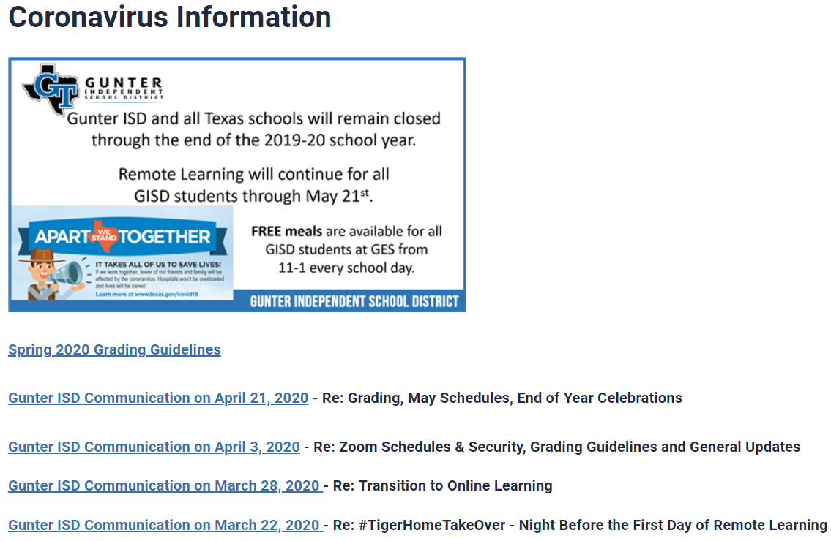

COMMUNICATION
Parent Emails
Remind
Social Media
Surveys / Feedback Forms
Learning Platform

Slide 24
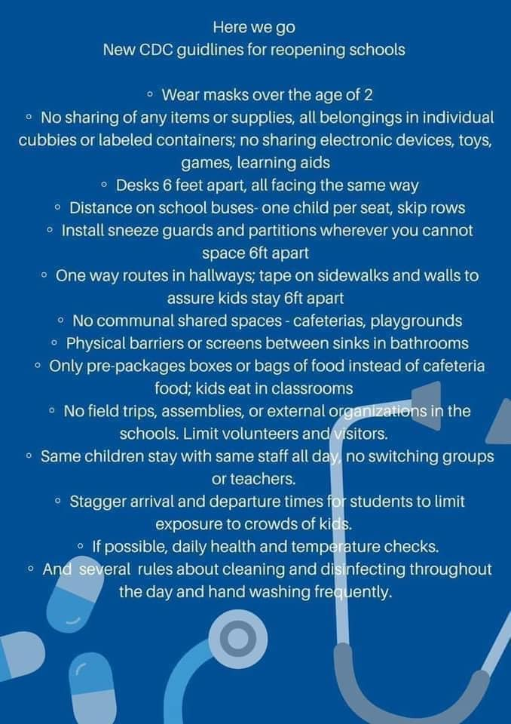

SOCIAL MEDIA
Not True!
Except it could be true…

Slide 25
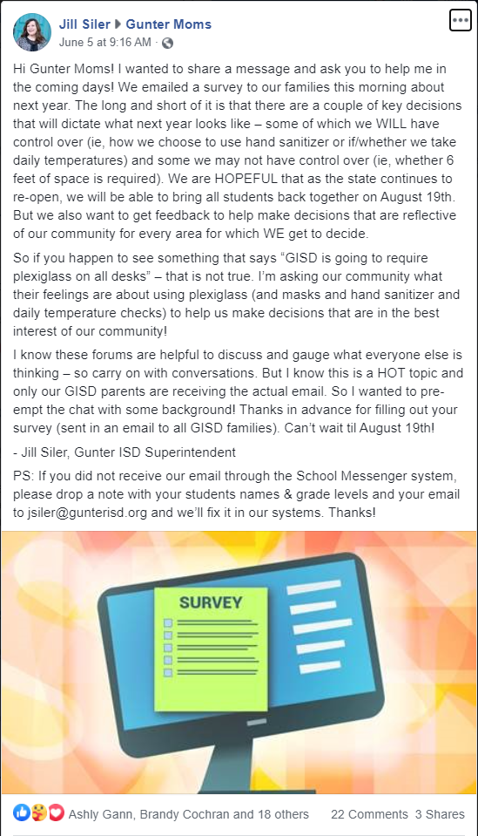
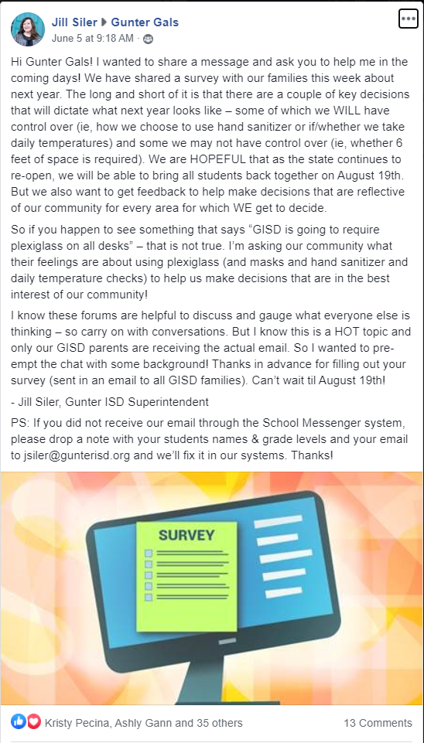
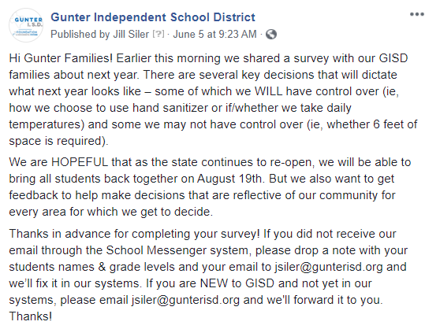
SOCIAL MEDIA

Slide 26
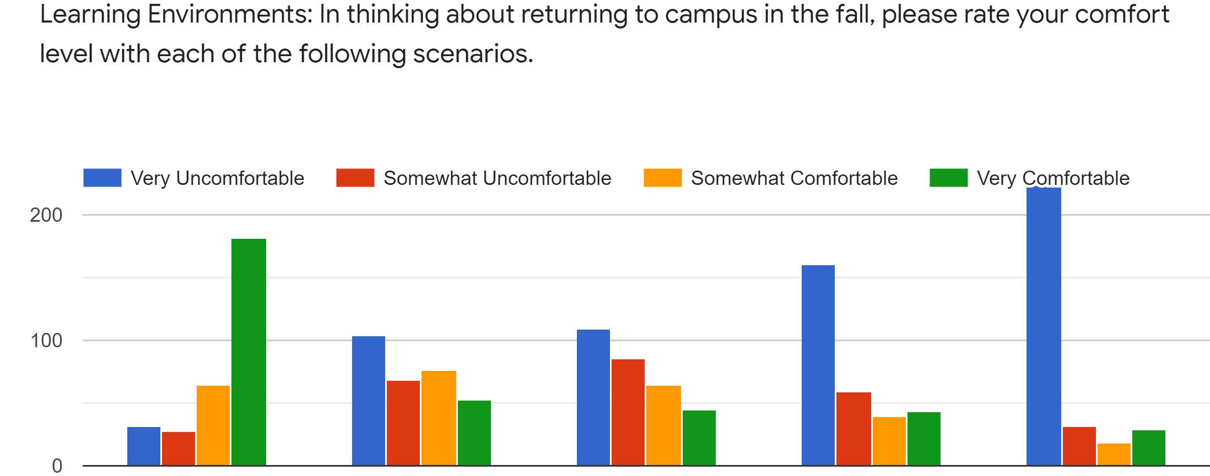
PARENT SURVEYS
Returning 100% students present
Returning w/Safety Measures (masks, plexiglass, etc.)
Returning w/ Social Distancing
Remain Online until Safer to Return
Remain Online for 2020-21

Slide 27
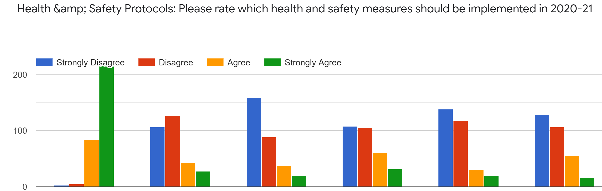
PARENT SURVEYS
&
Wash Hands Frequently
Employees Wear Masks
Students Wear Masks
Social Distancing
Eliminate Large Group Gatherings
Plexiglass on Desks

Slide 28
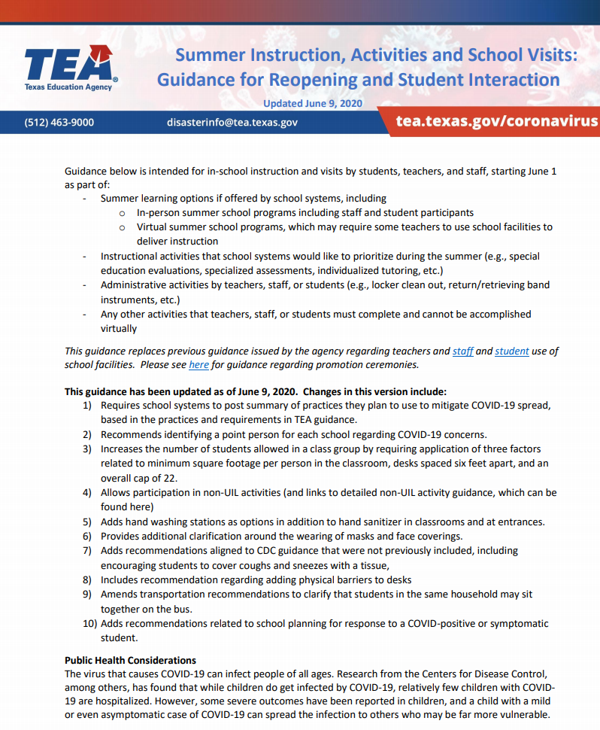
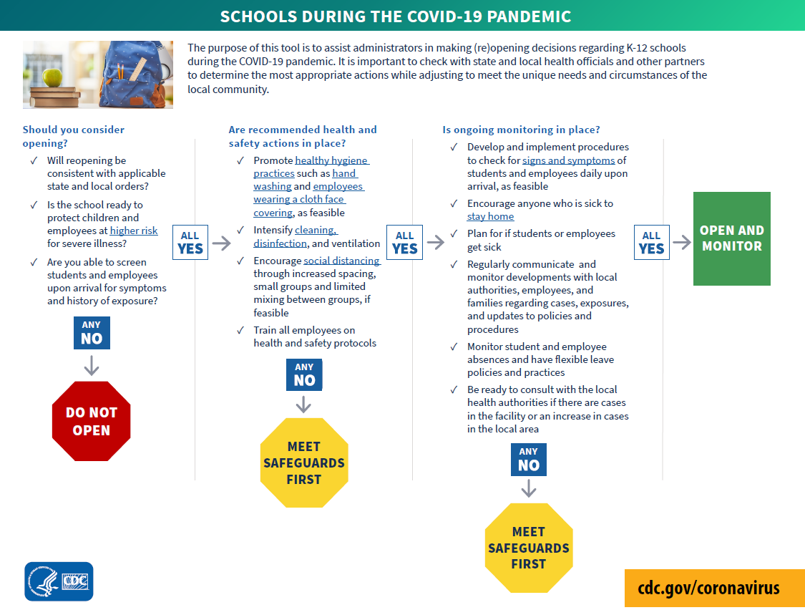

HOW DO YOU BALANCE?

Slide 29
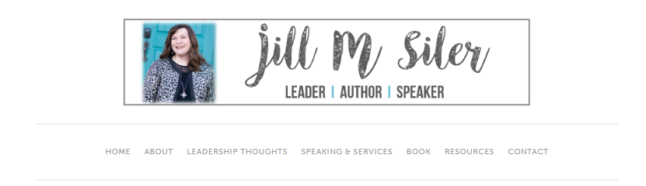
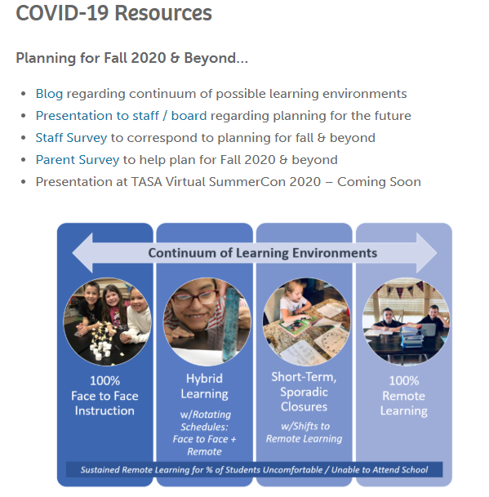
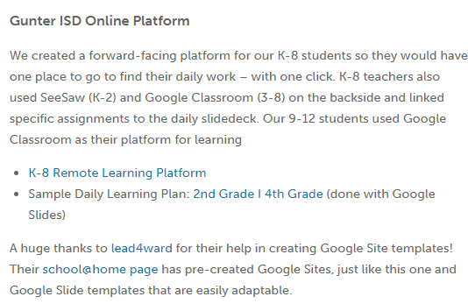
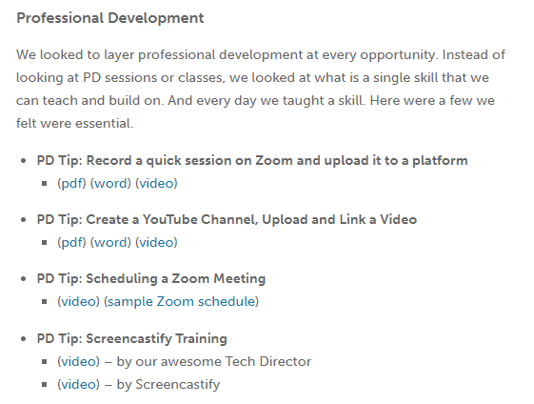
RESOURCES
jillmsiler.com/covid-19

Slide 30
Helpful Links
CDC Guidance for School Re-Opening
School Superintendents will Follow Leaked CDC Guidance on Reopening Schools
“Between 0 and 100%”: Texas schools weigh the odds of students returning this fall
NIET – Scenario Planning: Considerations for 2020-21
Arizona’s three-phase approach to crafting school reopening plan
7 questions schools will have to answer to reopen in fall 2020
Katie Martin: 6 Ideas for Creating a Remote Community of Learners
Larry Ferlazzo: Best Posts Predicting What School Will Look Like in the Fall
George Couros: 5 Hopes for When Schools Reopen Face-To-Face
Jeremy Parrish: Do I Dare Disturb the Universe?

Slide 31
Planning for 2020-2021
We may not know what the 2020-21 school year will look like at any given moment, but we do know that it will fall into some part of this continuum.
As leaders, we must prepare for it all.

Slide 32

CONTACT ME:
Email: jsiler@gunterisd.org
Social Media: @jillmsiler
Website: jillmsiler.com

